Slide 1
FarmRise Ui /API
Test Framework
Karthik Chalikandi

Slide 2
TOC
Overview
Tools and frameworks used
Framework Model
Architecture diagram
Market trends

Slide 3
Overview
Planning Phase for FarmRise Automation framework development includes.
Requirement analysis
Tool selections based on project requirement
Framework design and architecture along with CICD pipeline integration.

Slide 4


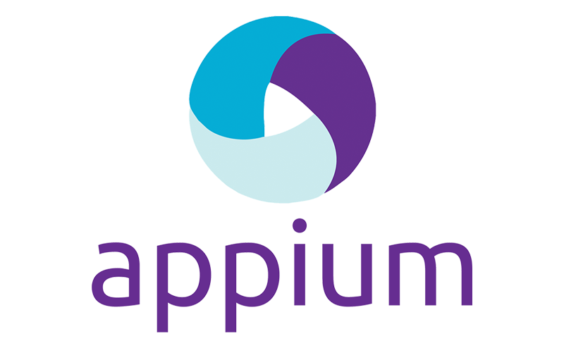
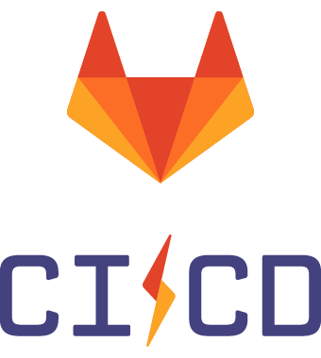
Tools, frameworks used / considered.
python
Robot Framework

Slide 5
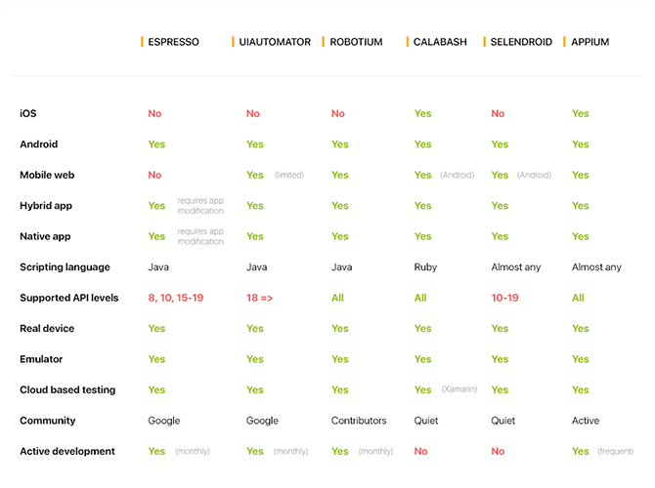
Why Appium over other options ?

Slide 6
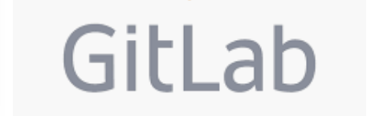
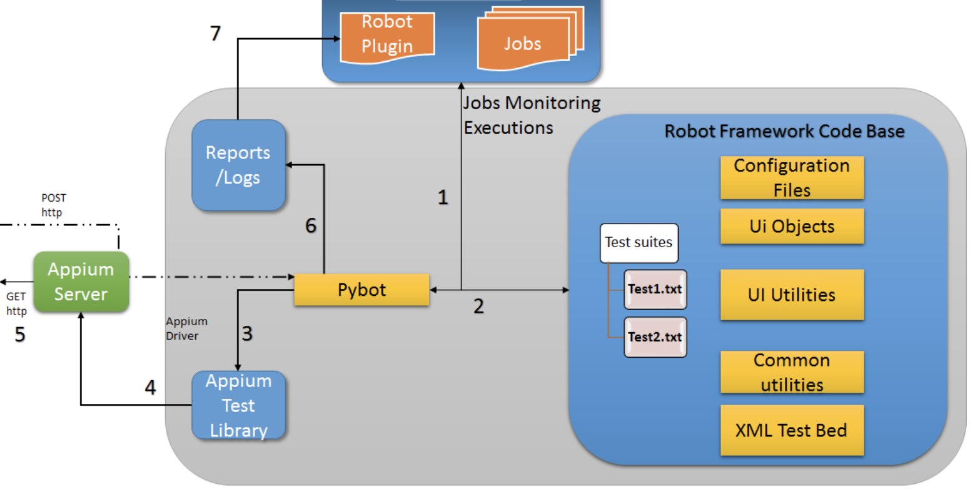
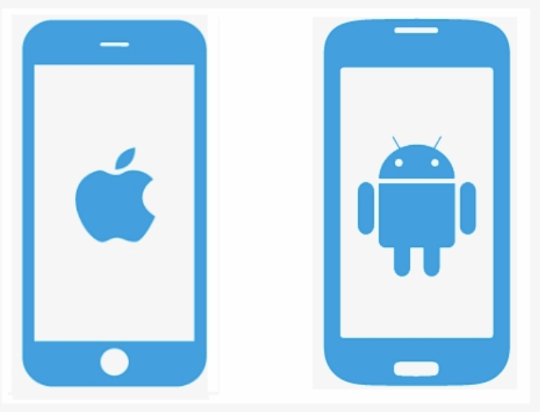
Automation framework architecture
8
TestRail
Real device or
emulator.

Slide 7
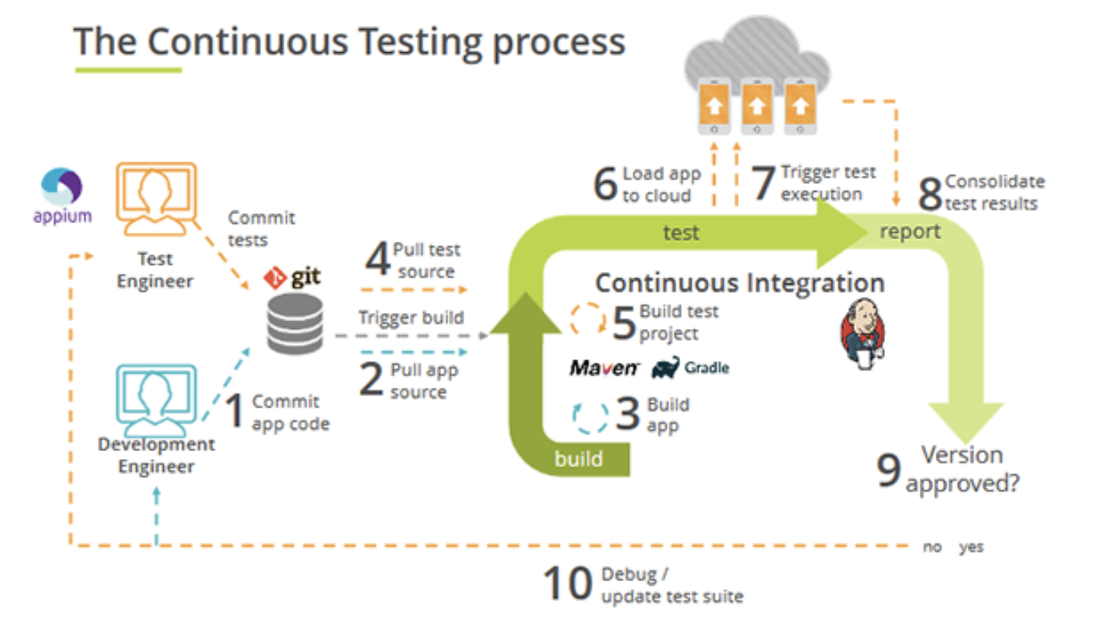
Framework integration with CI/CD.

Slide 8
Project timeline
JAN
FEB
MAR
APR
MAY
JUN
Requirement Analysis
Planning phase
Developing POC
Developing API’s
Test scripts
Integration with CICD
Understanding the product/project requirement for planning phase.
Includes tools selection, device short list, architecture draft.
Simple model of POC implementation with smoke suite.
Includes all supporting API’s like DB support, UI utilities, configurations , mock test data etc.
Generating scripts to match with suitable/ selected regression and sanity test suite
Creating pipeline for automation integration testing with build system in place, connecting output to test management tools like Test rail.

Slide 9

Thank you!

Slide 10
Dashboard view
Reporting module
Device config.
Robot Framework
Test suite selection
Test type selection
Rester / Rest assured API library
Account login
Automation FW backend
Automation FW Frontend GUI

